Slide 1


INET 4707 | PostgreSQL
Correctional Facility Management
SYSTEM DATABASE
Aye Keita | Arafat Oyeneye | Brandon Hafferman | Alec burns | Henok Tekle

Slide 2

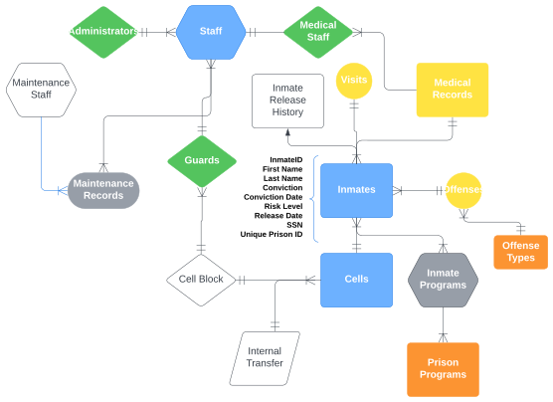
INTRODUCTION
Brief Overview of the Project:
This project involves designing a relational database to streamline operations in a prison facility.
The database manages prisoner intake, sentence durations, behavior records, rehabilitation programs, visitor logs, and release schedules.
Objective of the Database:
To simplify data management for the prison system.
Provide actionable insights for improving security and rehabilitation outcomes.
Ensure compliance with state and federal regulations through accurate reporting.

Slide 3
Business Description
Description of the Chosen Business:
This database is designed for a prison facility to manage critical operations, including tracking inmate information, rehabilitation programs, health records, and visitor logs.
OBJECTIVES
Justification for the Choice:
Prisons deal with large volumes of data that need efficient management systems to ensure accuracy in inmate profiles, monitor security incidents, and maintain compliance with reporting requirements.
Organize and manage inmate information, programs, health records, and visitor logs efficiently.
Improve security and track inmate progress in rehabilitation programs.
Ensure accurate reporting for government compliance.
Strategic Goal:
Leverage data to enhance security protocols, improve rehabilitation outcomes, and meet government compliance standards.
Tactical Goal:
Create a secure and user-friendly database interface, ensuring all departments can input and access data seamlessly.
Operational Goal:
Conduct regular data audits, produce monthly reports on inmate progress and incidents, and track the success of rehabilitation programs.

Slide 4
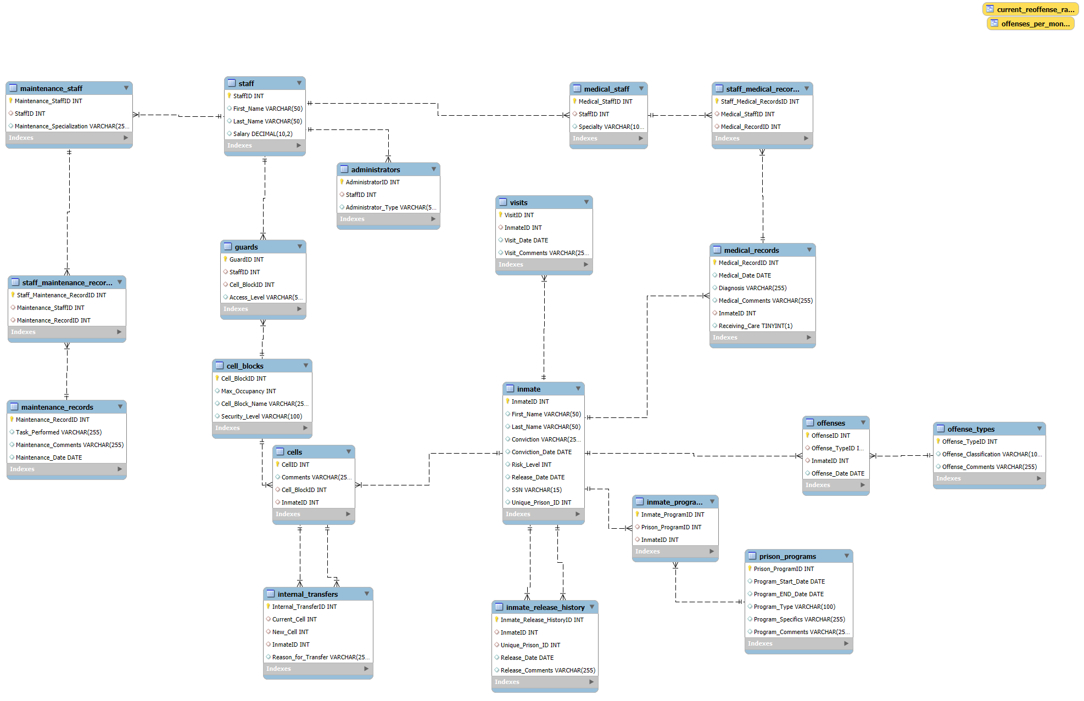

Slide 5

Explanation of entities and relationships:
INMATES
inmates can have many visits
inmates can have many medical records
inmates can have many offenses
inmates can have many inmate programs
inmates to inmate release history
inmates to cells
STAFF
staff to maintenance staff (to maintenance records)
staff to guards (to cell_blocks)
staff to administrators
staff to medical staff (to medical records)
CELLS
cells to internal transfers
cells to cell blocks (a cell block can have many cells)
Entity Relationship Diagram

Slide 6

Table Structures
Staff Table (Supertype)
Primary Key: StaffID
Attributes:First_Name, Last_Name, Salary
Guards Table (Subtype of Staff)
Primary Key: GuardID
Foreign Keys: StaffID (References Staff(StaffID)),Cell_BlockID (References Cell_Blocks(Cell_BlockID))
Attributes:Access_Level
Administrators Table (Subtype of Staff)
Primary Key: AdministratorID
Foreign Key:StaffID (References Staff(StaffID))
Attributes:Administrator_Type
Maintenance Staff Table (Subtype of Staff)
Primary Key: Maintenance_StaffID
Foreign Key:StaffID (References Staff(StaffID))
Attributes:Maintenance_Specialization
Maintenance Records Table
Primary Key: Maintenance_RecordID
Attributes:Task_Performed, Maintenance_Comments, Maintenance_Date
Staff Maintenance Records Bridge Table
Primary Key: Staff_Maintenance_RecordID
Foreign Keys: Maintenance_StaffID (References Maintenance_Staff(Maintenance_StaffID)), Maintenance_RecordID (References Maintenance_Records(Maintenance_RecordID))
Medical Staff Table (Subtype of Staff)
Primary Key: Medical_StaffID
Foreign Key:StaffID (References Staff(StaffID))
Attributes:Specialty
Medical Records Table
Primary Key: Medical_RecordID
Foreign Key:InmateID (References Inmate(InmateID))
Attributes:Medical_Date, Diagnosis, Medical_Comments, Receiving_Care
Staff Medical Records Bridge Table
Primary Key: Staff_Medical_RecordsID
Foreign Keys:Medical_StaffID (References Medical_Staff(Medical_StaffID)), Medical_RecordID (References Medical_Records(Medical_RecordID))
Inmate Table
Primary Key: InmateID
Attributes:First_Name, Last_Name, Conviction, Conviction_Date, Risk_Level, Release_Date, SSN, Unique_Prison_ID
Cells Table
Primary Key: CellID
Foreign Keys:Cell_BlockID (References Cell_Blocks(Cell_BlockID)), InmateID (References Inmate(InmateID))
Attributes:Comments
Cell Blocks Table
Primary Key: Cell_BlockID
Attributes:Max_Occupancy, Cell_Block_Name, Security_Level
Visits Table
Primary Key: VisitID
Foreign Key:InmateID (References Inmate(InmateID))
Attributes:Visit_Date, Visit_Comments
Internal Transfers Table
Primary Key: Internal_TransferID
Foreign Keys:InmateID (References Inmate(InmateID)), Current_Cell (References Cells(CellID)), New_Cell (References Cells(CellID))
Attributes:Reason_for_Transfer
Inmate Release History Table
Primary Key: Inmate_Release_HistoryID
Foreign Keys:InmateID (References Inmate(InmateID)), Unique_Prison_ID (References Inmate(Unique_Prison_ID))
Attributes:Release_Date,Release_Comments
Prison Programs Table
Primary Key: Prison_ProgramID
Attributes:Program_Start_Date,Program_END_Date,Program_Type,Program_Specifics,Program_Comments
Inmate Programs Bridge Table
Primary Key: Inmate_ProgramID
Foreign Keys:Prison_ProgramID (References Prison_Programs(Prison_ProgramID)), InmateID (References Inmate(InmateID))
Offense Types Table
Primary Key: Offense_TypeID
Attributes:Offense_Classification, Offense_Comments
Offenses Table
Primary Key: OffenseID
Foreign Keys:Offense_TypeID (References Offense_Types(Offense_TypeID)), InmateID (References Inmate(InmateID))
Attributes:Offense_Date

Slide 7
In 1NF
NORMALIZATION PROCESS
With atomic values (Ex: Name of inmates and staff split into first_name, last_name attribute)
Primary key (all entities on our tables have primary keys.)
In 2NF
Steps taken to normalize the tables and an explanation of each normal form applied:
With no partial dependencies (primary key does not partially determine other attributes).
In 3NF
with no transitive dependencies between non-key attributes (attributes do not depend on one attribute that depends on another). (Not A-> B B-> C)

Slide 8

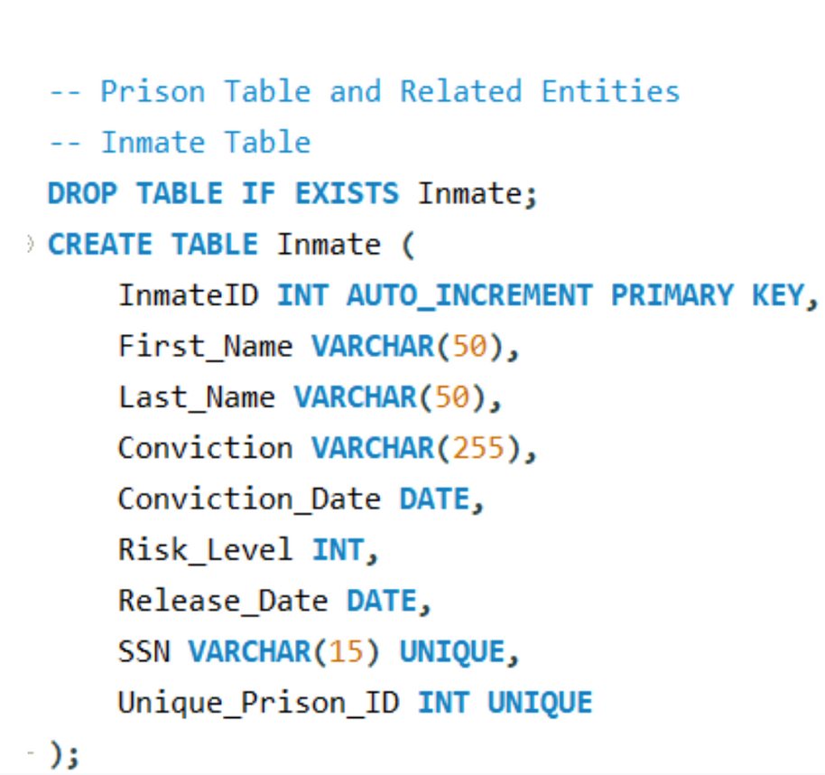
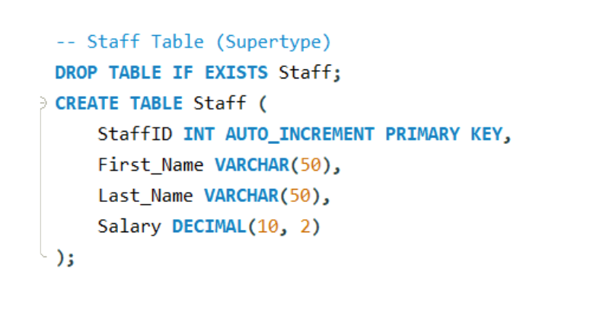
SQL Commands for Table Creation
Notes:
brandon
talk about basic table layout and how all staff are a subtype of staff

Slide 9
VIEWS/KPI’S
Upcoming release dates for the current and/or selected month.
Select the offense table for the current week to see how many offenses were committed for each inmate in the offenses table
Current enrolment in prison programs: view of the number of prisoners in our current programs
enrolment data for college, religious, etc programs
Prisoners receiving current medical care
View of current escape attempts for this year. Grab data from the offenses table and look for escape attempts
View of current reoffense rate for our prison. How many inmates appear more than once in the inmate release history table

Slide 10

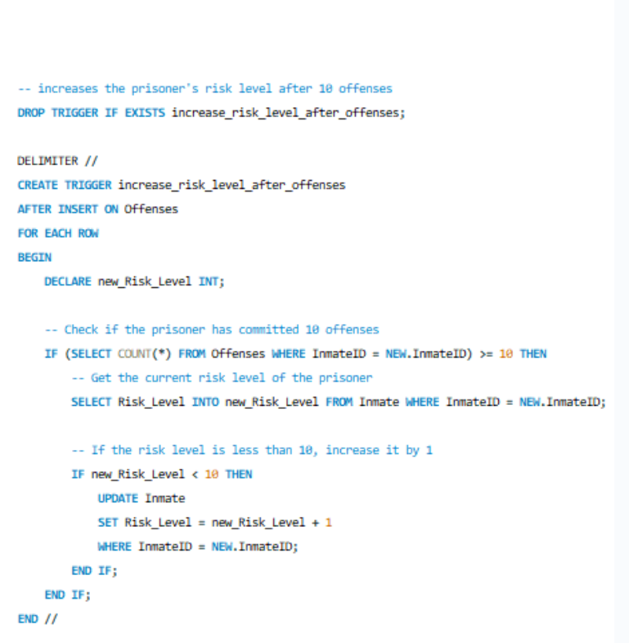
TRIGGERS
When an inmate release date arrives, move the inmate to the release history table.
Every time the internal transfers transfers table is updated also update the cell and cell block tables
When a prisoner comments 10 offences their risk level will increase by 1:
This means the security level is a number with 1 being low and 10 being the highest.
On an insert for guards also insert on the staff table.
on insert of subtype insert for super type too.
Set default values for Inmates table before insert on said table if values are NULL the assign basic value to them. Also create unique Inmate ID

Slide 11
Stored Procedure
Explanation of the stored procedure
SQL script for the stored procedure
DELIMITER //: Changes the statement delimiter to this symbol // to allow the definition of the stored procedure.
CREATE PROCEDURE insert_inmate: Defines a new stored procedure named insert_inmate.
IN inmate_first_name VARCHAR(50), ...: Input parameters for the stored procedure.
DECLARE inmate_id INT;: Declares a local variable inmate_id to store the last inserted ID.
INSERT INTO Inmates...: Inserts a new record into the Inmates table.
SET inmate_id = LAST_INSERT_ID();: Retrieves the ID of the last inserted row.
UPDATE Cells...: Updates the Cells table with a comment indicating the inmate assignment.
-- Create the insert_inmate procedure
DELIMITER //
CREATE PROCEDURE insert_inmate(
IN inmate_first_name VARCHAR(50),
IN inmate_last_name VARCHAR(50),
IN conviction_text TEXT,
IN conviction_date DATE,
IN risk_level INT,
IN release_date DATE,
IN cell_id INT
)
BEGIN
DECLARE inmate_id INT;
-- Insert into the Inmates table
INSERT INTO Inmates (first_name, last_name, conviction, conviction_date, risk_level, release_date, cell_id)
VALUES (inmate_first_name, inmate_last_name, conviction_text, conviction_date, risk_level, release_date, cell_id);
-- Get the last inserted inmate_id
SET inmate_id = LAST_INSERT_ID();
-- Update the Cells table with the inmate assignment
UPDATE Cells SET comments = CONCAT(comments, ', Inmate ID: ', inmate_id) WHERE cell_id = cell_id;
END //
DELIMITER ;
Notes:
Arafat

Slide 12
Sample Data
Example data inserted into the tables
-- Insert sample data into Cell_Blocks
INSERT INTO Cell_Blocks (block_name, max_occupancy, security_level) VALUES
('Block A', 100, 'Maximum'),
('Block B', 150, 'Medium'),
('Block C', 120, 'Minimum');
-- Insert sample data into Cells
INSERT INTO Cells (comments, cell_block_id) VALUES
('Clean and well-maintained', 1),
('Requires minor repairs', 2),
('Spacious cell', 3);
-- Insert sample data into Staff
INSERT INTO Staff (first_name, last_name, salary) VALUES
('John', 'Doe', 50000),
('Jane', 'Smith', 55000),
('Michael', 'Johnson', 48000);
-- Insert sample data into Inmates
INSERT INTO Inmates (first_name, last_name, conviction, conviction_date, risk_level, release_date, cell_id) VALUES
('James', 'Brown', 'Theft', '2022-01-15', 5, '2025-01-15', 1),
('Robert', 'Williams', 'Assault', '2021-03-20', 7, '2026-03-20', 2),
('David', 'Jones', 'Drug Trafficking', '2020-05-10', 6, '2028-05-10', 3);
-- Insert sample data into Visits
INSERT INTO Visits (inmate_id, visit_date, visit_comments) VALUES
(1, '2023-04-10', 'Family visit'),
(2, '2023-04-11', 'Lawyer visit'),
(3, '2023-04-12', 'Friend visit');
-- Insert sample data into Offenses
INSERT INTO Offenses (inmate_id, offense_date, description) VALUES
(1, '2022-06-10', 'Disobeying orders'),
(2, '2022-07-15', 'Fighting with other inmates'),
(3, '2022-08-20', 'Possession of contraband');
-- Insert sample data into Internal_Transfers
INSERT INTO Internal_Transfers (inmate_id, current_cell_id, new_cell_id, reason_for_transfer) VALUES
(1, 1, 2, 'Routine transfer'),
(2, 2, 3, 'Security reasons'),
(3, 3, 1, 'Behavioral issues');
-- Insert sample data into Inmate_Release_History
INSERT INTO Inmate_Release_History (inmate_id, release_date, release_comments) VALUES
(1, '2025-01-15', 'Released on parole'),
(2, '2026-03-20', 'Sentence completed'),
(3, '2028-05-10', 'Good behavior release');
Notes:
Arafat

Slide 13
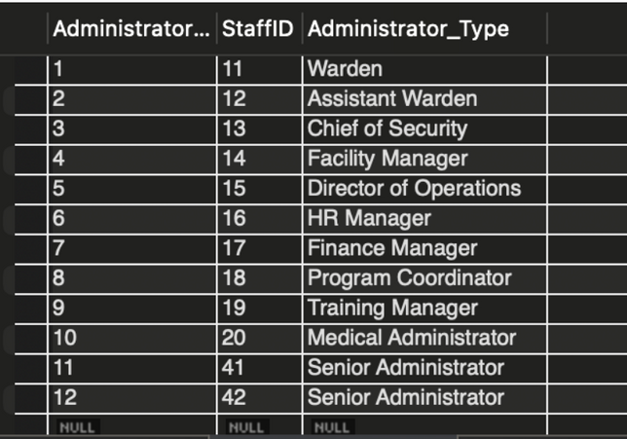
QUERIES AND REPORTS
Reports generated from the data:
Sample queries and their outputs
-- test
CALL Insert_Staff_Admin('John', 'Doe', 50000.00, 'Senior Administrator');
-- Verify the data
SELECT * FROM Staff;
SELECT * FROM Administrators;

Slide 14
Conclusion
Summary of the project
Key learnings and challenges
DESIGNED A RELATIONAL DATABASE TO MANAGE PRISONER INTAKE, SENTENCE DURATIONS, BEHAVIOR RECORDS, REHABILITATION PROGRAMS, VISITOR LOGS, AND RELEASE SCHEDULES
IMPORTANCE OF ALIGNING DESIGN WITH OPERATIONAL GOALS AND MAINTAINING DATA ACCURACY.
ADDRESSING COMPLEX DATA INTERDEPENDENCIES AND ENSURING SCALABILITY.

Slide 15
INET 4707 | PostgreSQL
REFERENCES
A reference we used while designing our database’s entities: https://study.com/academy/lesson/parts-prison-design-structure.html#:~:text=Although%20there%20are%20many%20kinds,rooms%2C%20and%20outdoor%20activity%20areas.

